Slide 1

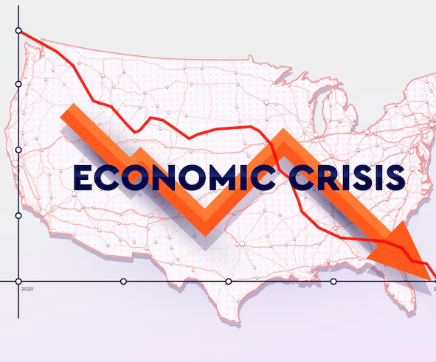
The Great Depression and the Crisis of Capitalism
BY
MAYUKH PAUL REGISTRATION NO – 220010026832
ENROLNMENT NO – 2211212001006
SISTER NIVEDITA UNIVERSITY
KOLKATA- 700156

Slide 2
CONTENT PAGE
01. INTRODUCTION TO GREAT DEPRESSION
0.2 LINK OF GREAT DEPRESSION
0.3 CAUSES OF GREAT DEPRESSION
0.4 IMPACT OF DEPRESSION
0.5 CONCLUSION POV

Slide 3
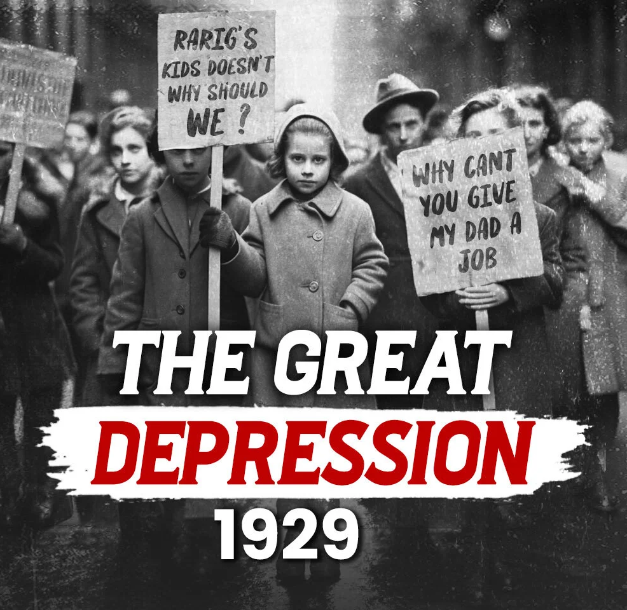
Introduction to the Great Depression
The Great Depression was a severe worldwide economic downturn that began with the U.S. stock market crash in October 1929 and lasted through much of the 1930s. It became the longest and most widespread depression of the 20th century.

Slide 4
Linking of Great Depression
Global Impact
Spread rapidly from the United States to Europe, Latin America, and other parts of the world due to interconnected trade and finance systems.
Industrial production collapsed, banks failed, and international trade plummeted.
Tens of millions lost jobs and homes, with poverty and hunger rising sharply worldwide.
Link to Capitalist Economic Systems: The Depression exposed structural weaknesses in capitalist economies, including overproduction, speculation, and lack of regulation. Unregulated markets and the belief in self-correcting systems failed to prevent or respond to the collapse. Sparked global debates on capitalism, leading to stronger state intervention, social safety nets, and the emergence of Keynesian economics.

Slide 5
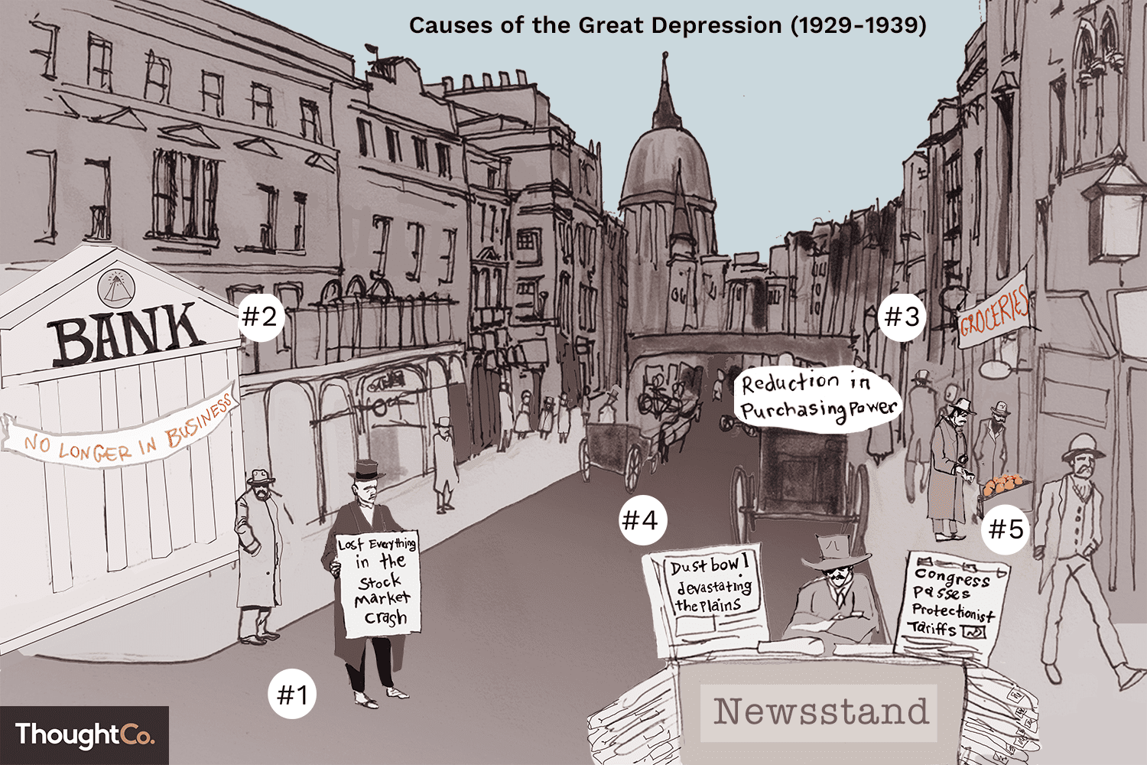
CAUSE OF GREAT DEPRESSION
Stock Market Crash of 1929
- Sudden collapse in stock prices on Wall Street triggered panic and loss of investor confidence.
Overproduction and Underconsumption
- Industries produced more goods than people could afford to buy, leading to unsold inventory and layoffs.
Banking Failures and Credit Collapse
- Thousands of banks failed; people lost savings, and businesses couldn’t access credit to stay afloat.
International Debt and Trade Imbalances
- Post-WWI debt burdens, protectionist policies like U.S. tariffs and declining global trade worsened the crisis.
Structural Weaknesses in Capitalism
- Unequal income distribution, lack of government regulation, and speculative investments revealed deep flaws in the capitalist system.

Slide 6
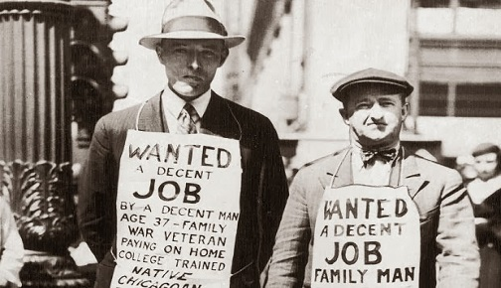
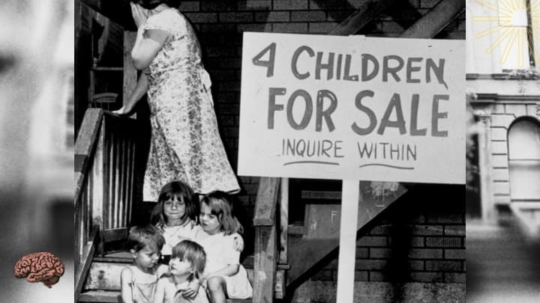
Impact of depression
Mass Unemployment and Poverty
Millions lost jobs; families struggled with homelessness, hunger, and falling living standards.
Bank Closures and Loss of Savings
Bank runs and failures wiped out personal savings, shaking public trust in financial institutions.
Decline in Industrial Production
Factories shut down or slowed production, leading to further layoffs and economic contraction.
Global Ripple Effect
Economic crisis spread beyond the U.S., especially hitting Europe hard—Germany, Britain, and others faced severe downturns.

Slide 7
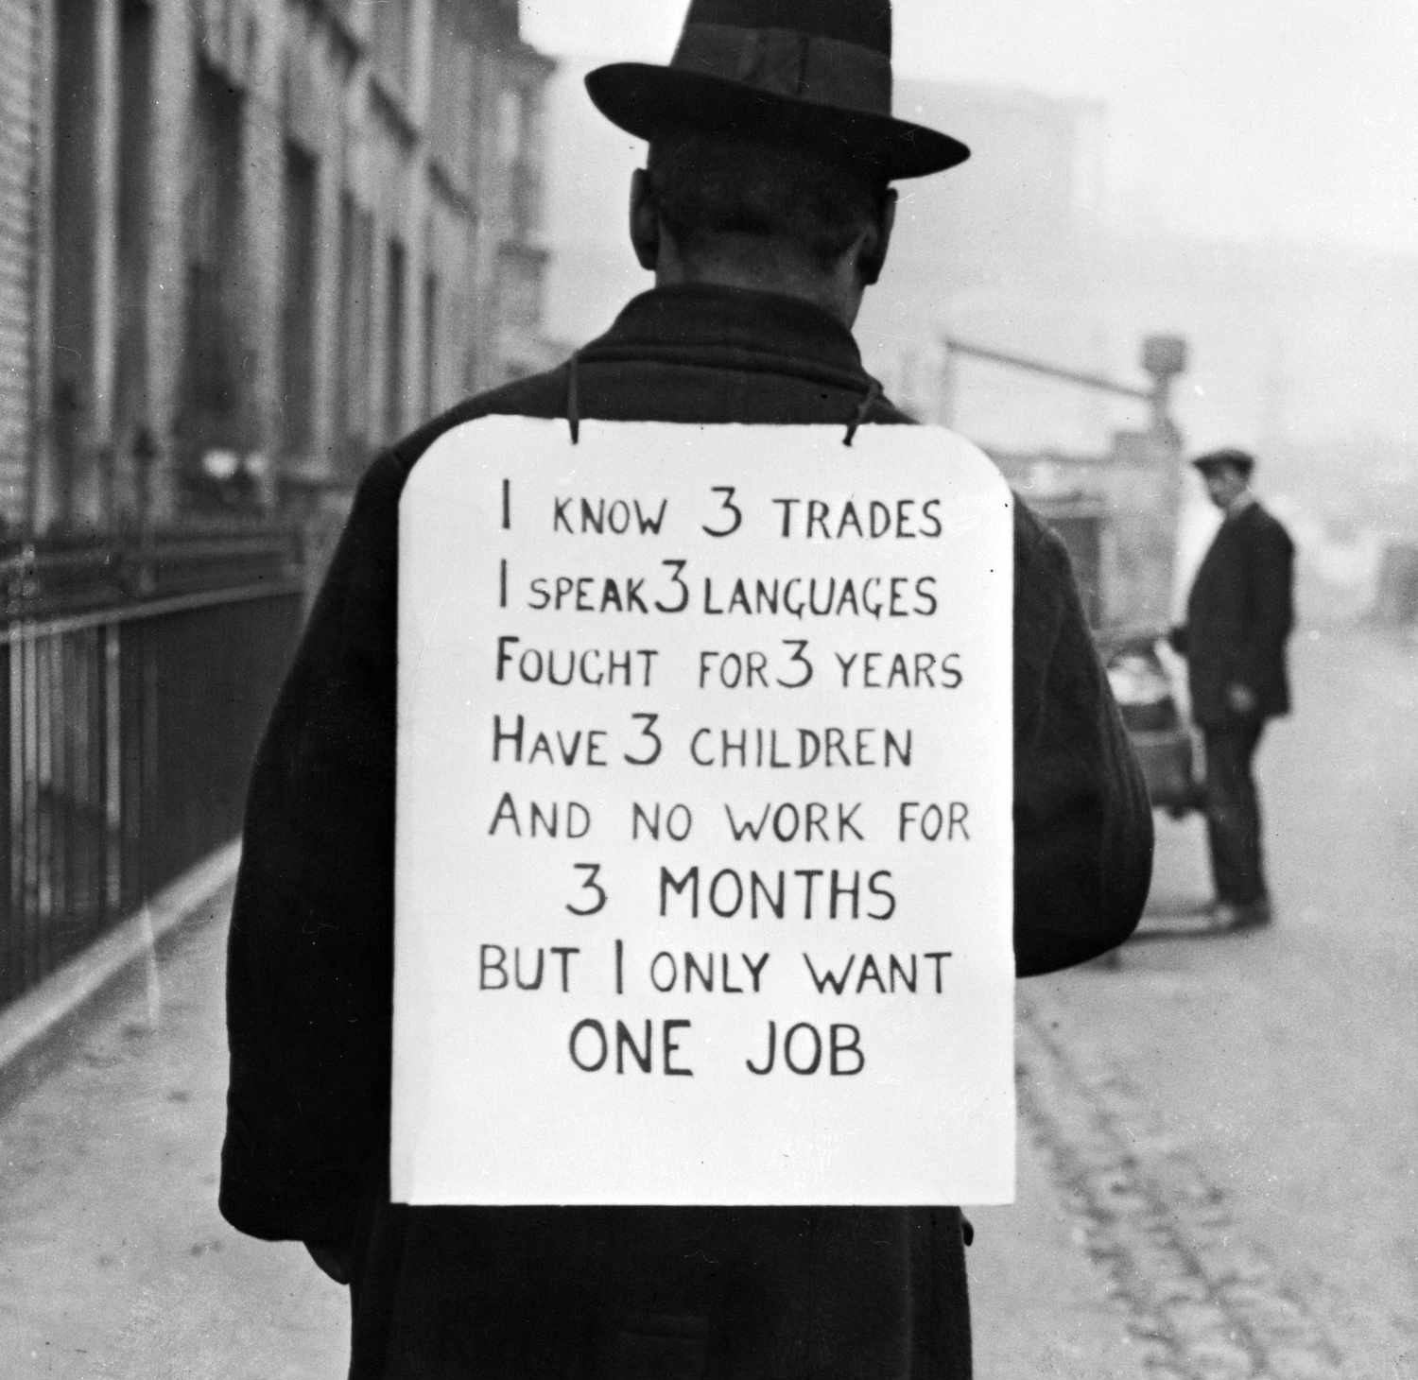
Conclusion
The Great Depression (1929–1939) was a defining moment in global economic history. It exposed the deep vulnerabilities of unregulated capitalism and highlighted the social costs of financial and industrial collapse.
It led to unprecedented economic hardship, with mass unemployment, poverty, and global instability.
The crisis challenged the foundations of laissez-faire economics, forcing governments to take a more active role in managing their economies.
It gave rise to major reforms, such as Roosevelt’s New Deal, and influenced the development of modern welfare states and regulated capitalism.
Lasting Impact: The Depression reshaped economic thought, policy, and institutions—and its lessons remain relevant today as we continue to confront financial crises, inequality, and debates over the future of capitalism.
Final Thought: The Great Depression was more than a historical event—it was a turning point that forced societies to ask: How can we build an economy that works for all?

Slide 8
THANK YOU!

